Slide 1
Identifying Factors Associated with Residence in Subsectors of a Rochester Neighborhood
Joseph Blubaugh, Anne Geraci, Rachael Glazner, Shannon Nitroy

Slide 2
Background
NeighborWorks®: Organization with the goal of improving neighborhoods in Rochester, New York
Duties include:
Home ownership education
Community focused home improvement lending
Energy conservation services

Slide 3
NeighborWorks Healthy Blocks Initiative
Focuses on improving the following:
Physical condition of homes
Resident engagement and leadership
Neighborhood image and identity
This initiative collected survey data to better understand how to make these improvements

Slide 4
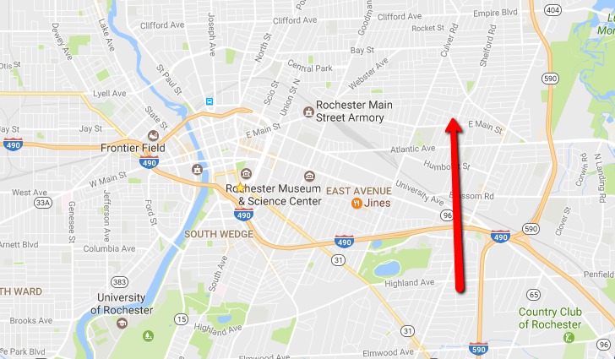
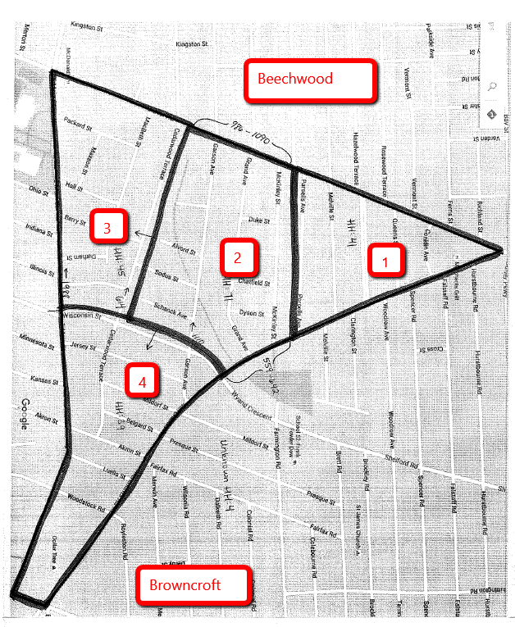
Area of Focus: “Triangle of North Winton Village” (“The Triangle”)
Figure 1. Location of The Triangle in Rochester, New York
Figure 2. Sub-sectors of The Triangle

Slide 5
Objective
Using the survey data provided by the NeighborWorks Healthy Blocks Initiative, our goal is to determine if there are statistically significant differences between the subsectors within The Triangle (labeled 1 through 4), and if the length of time a resident has remained in an area is also associated with other various factors.

Slide 6
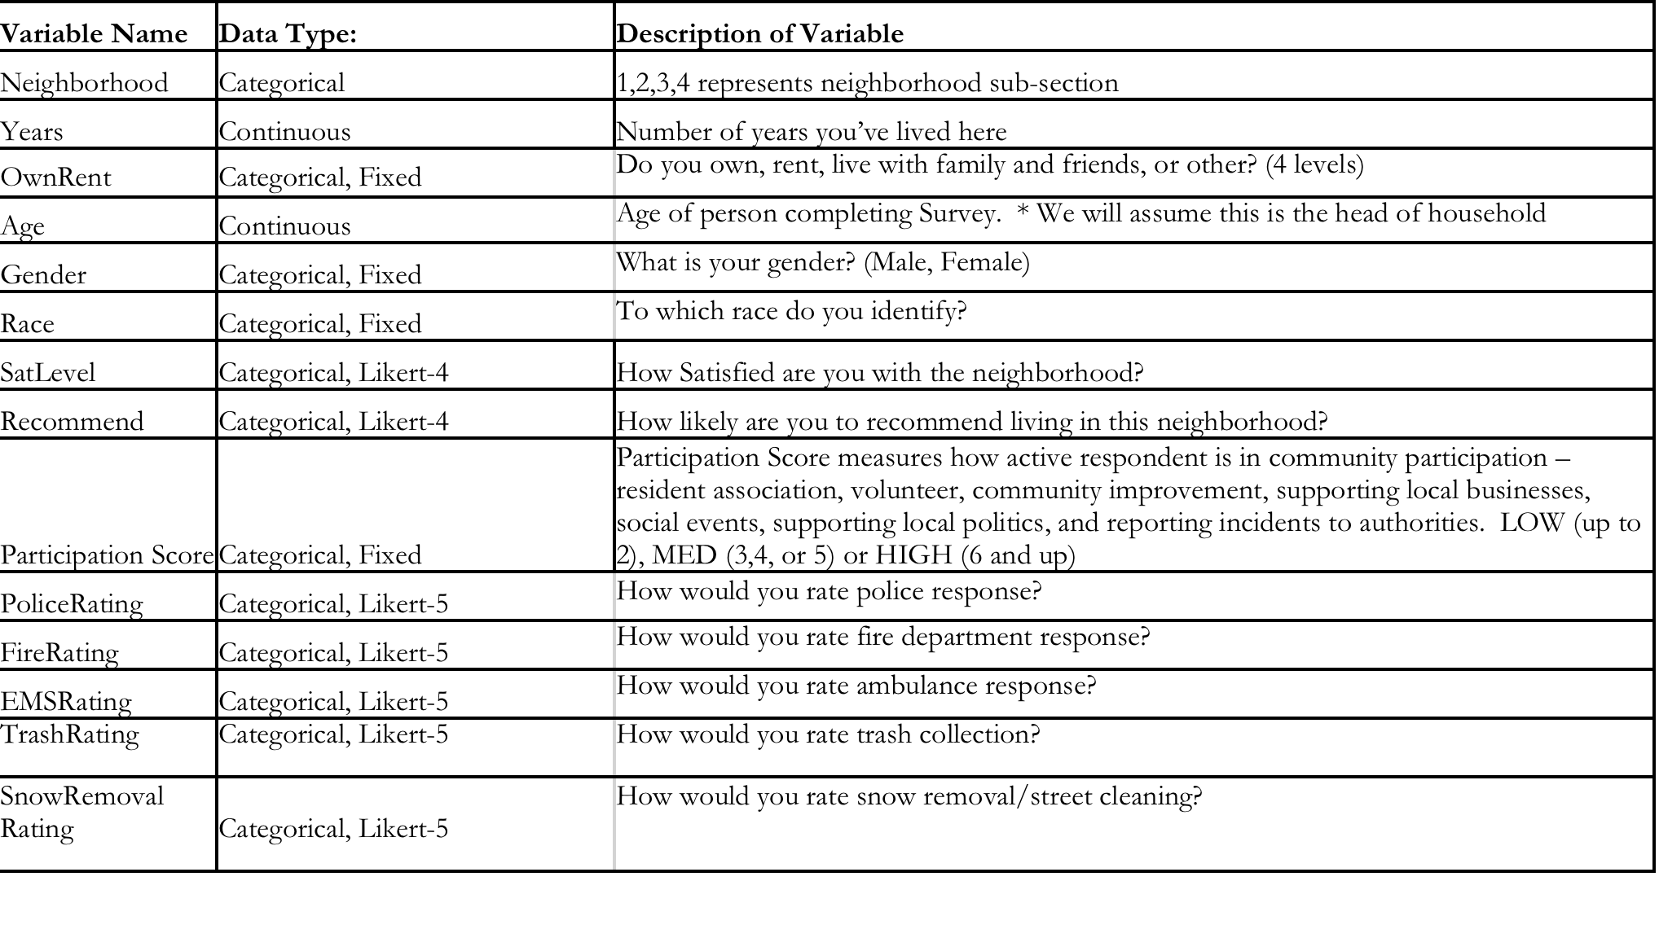
Data Source
Mid-term survey (Year 3 of 5)
200 responses from door-to-door survey of 450 households randomly selected from 1200 households in neighborhood

Slide 7
Model
We constructed an ANCOVA regression on the number of years the participant has resided in the area.
Response variable (years) is continuous, and explanatory variables are either discrete or continuous.
We analyzed all data and models using JMP
Initial model:
log(Years) = NeighborhoodID + Age + RecommendCat + Gender + FeelSafeNightCat + SatLevelCat + Race + SnowRemovalCat + ParticipationScoreCat + OwnRent + PoliceRating + FeelSafeDayCat + TrashRatingCat

Slide 8
Full Model Results
Several covariates are insignificant:
Image of JMP table should go here

Slide 9
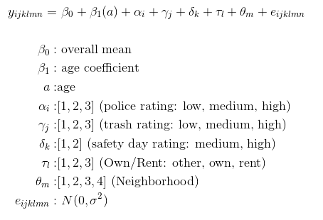
Final Model
We removed the insignificant covariates, but kept NeighborhoodID because of its interest in this study, resulting in the following model:

Slide 10
Results
Figure 3. Model Output
Table 1. Model Output

Slide 11
Results when NeighborhoodID is removed
Figure 4. Output removing Neighborhood ID
Table 2. Output removing Neighborhood ID
Although coefficient p-values change slightly when NeighborhoodID is removed, the significance, signs, and R-squared remain the same, and therefore NeighborhoodID was kept in the final model.

Slide 12
Differences Between Subsectors
Differences between pairs of subsectors were compared using Tukey HSD:
Table 3. Estimates comparing subsectors
No pairs of subsectors have significantly different years of residence
Least squares means for each subsector are very close in value

Slide 13
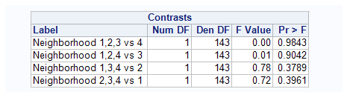
Differences Between Subsectors
Table 4. Contrasts for each subsector and the remaining subsectors
No contrasts were significant, indicating that the years of residence within any of the 4 subsectors was not significantly different from the years of residence in the remaining 3 subsectors.

Slide 14
Discussion
People tend to live in each subsector for the same amount of time
Significant factors that contributed to the years of residence:
Age (as age increases, years of residence increases)
Home ownership (home owners have more years of residence)
Day safety rating (as people feel safer during the day, years of residence increases)
Police ratings (as satisfaction with police response increases, years of residence decreases)
Trash ratings (as satisfaction with trash collection increases, years of residence decreases)
Unexpected signs of some coefficients (police ratings and trash ratings) may indicate omission of variable bias.

